Slide 1

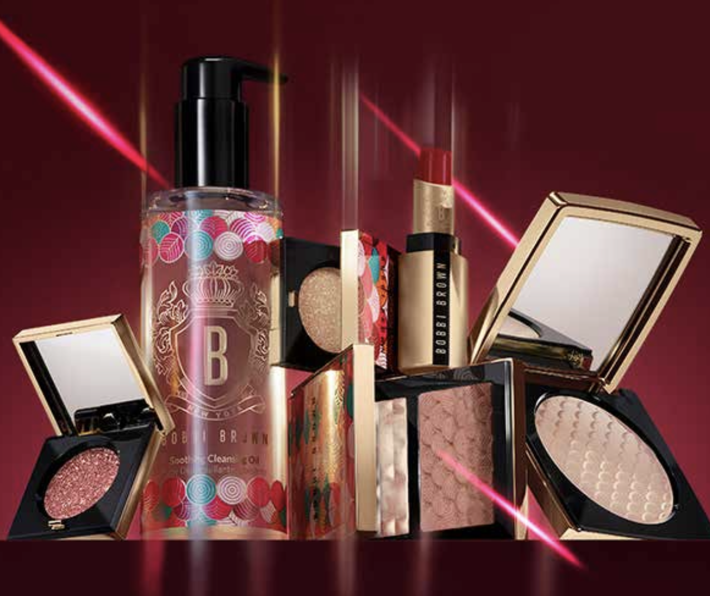
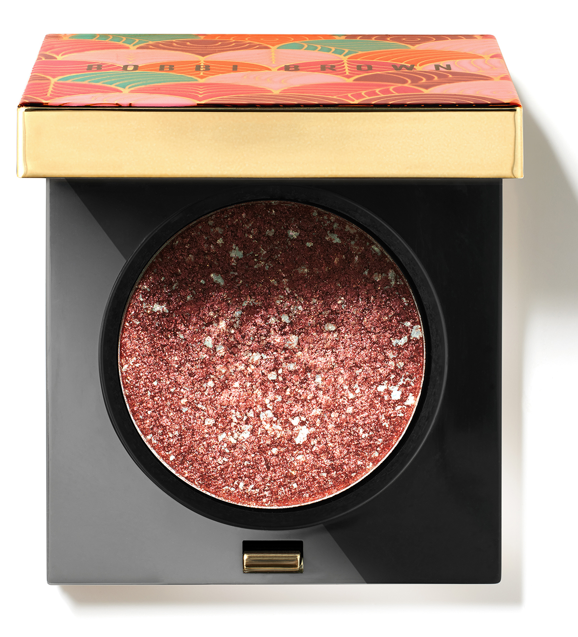
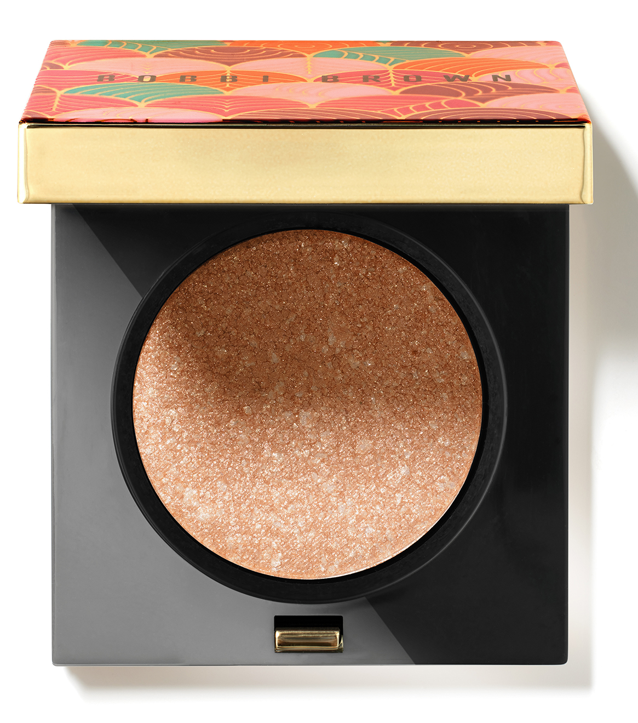
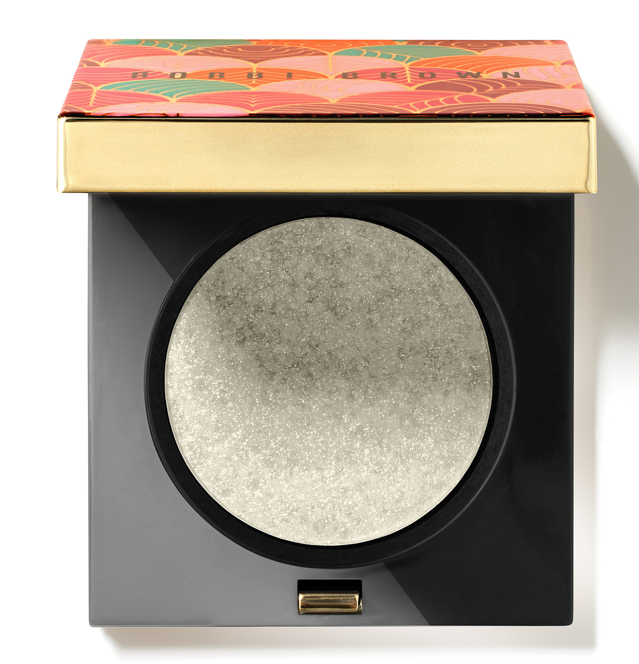
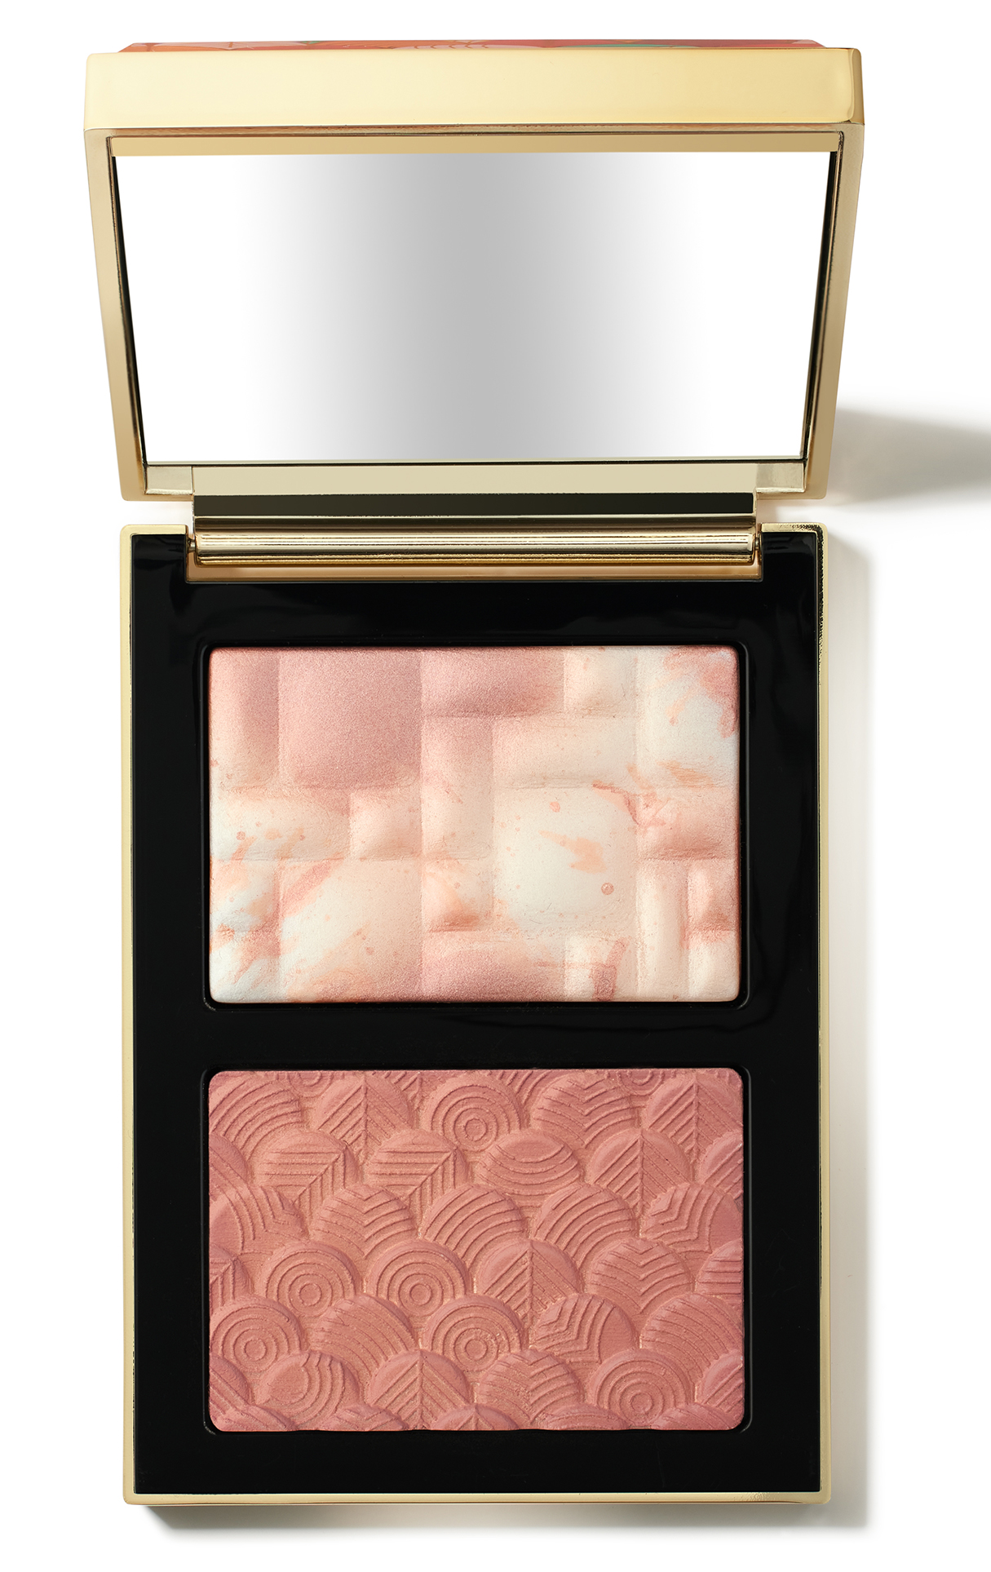
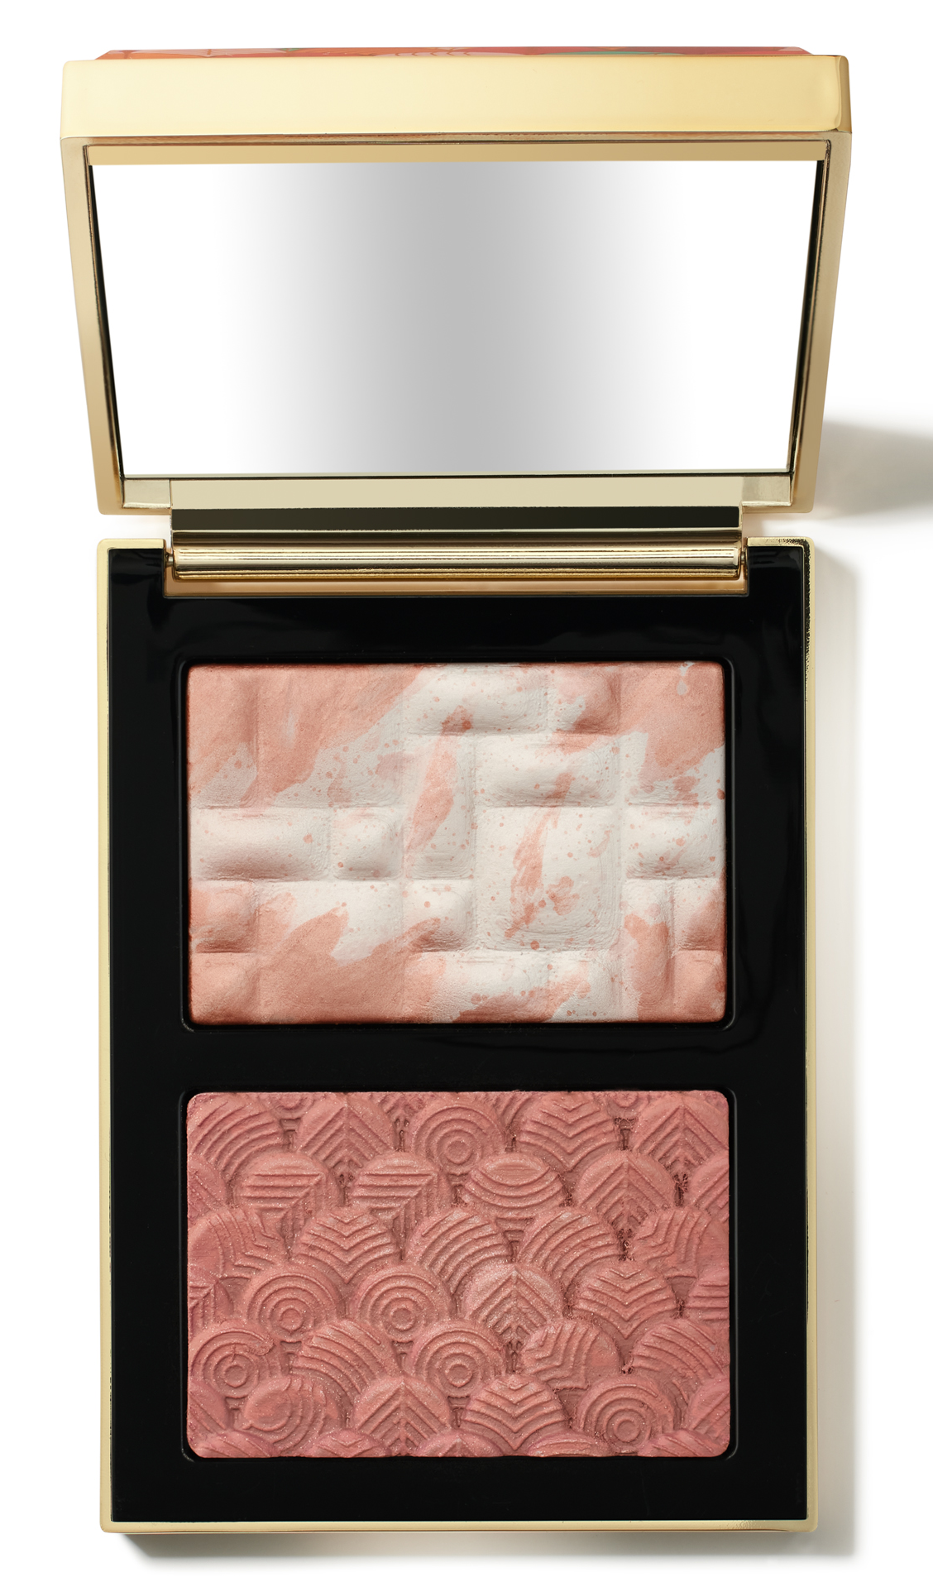
GLOW WITH LUCK COLLECTION
POWER YOUR GLOW
Introducing the Glow With Luck Collection.
This Lunar New Year, look boldly to the future with luxe formulas and vibrant shades to create a glowing look for stepping confidently into the New Year.
A new year. A more powerful you. Our Limited-Edition Glow With Luck Collection ignites your glow with luxe formulas and vibrant essentials, while a colorful dragon-inspired design fires up the spirit with gleaming good fortune.
Luxe Eye Shadow SINGLES
A shining eye shadow formula designed to give eyes a glistening glow. In a new rich glimmer finish, this shadow takes looks to the next level with sophisticated shimmer and soft color. SRP: €52
Garnet
Sparkler
Full Moon
BLUSH & HIGHLIGHTER DUOS
Combining our bestselling Highlighting Powder with Radiant Blush, the Blush & Highlight Duo gives skin a glowing wash of color. Highlighting Powder delivers a translucent, lit-from-within glow, while Radiant Blush brightens cheeks with a natural-looking, radiant finish. SRP: €60
Pink Dawn Glow
Sunrise Glow
Available: January 2024 at Bobbi Brown Cosmetics Counters and at www.bobbibrown.be
For more information, please contact Marie Wauters - mwauters@be.clinique.com
Find us on social: @BobbiBrown #BobbiBrown

Slide 2
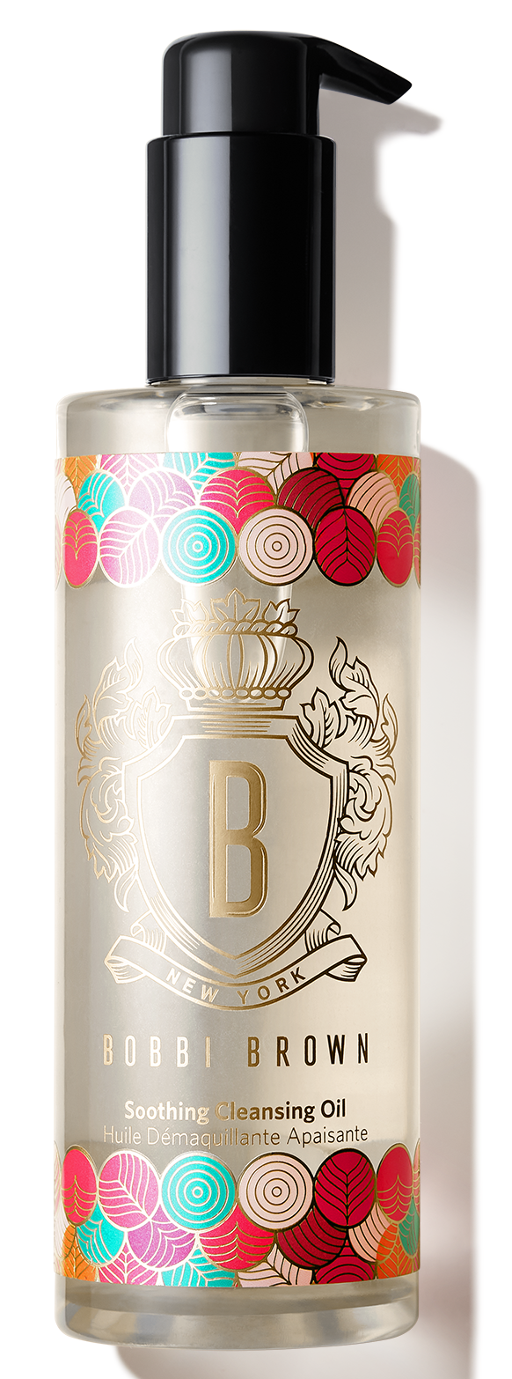
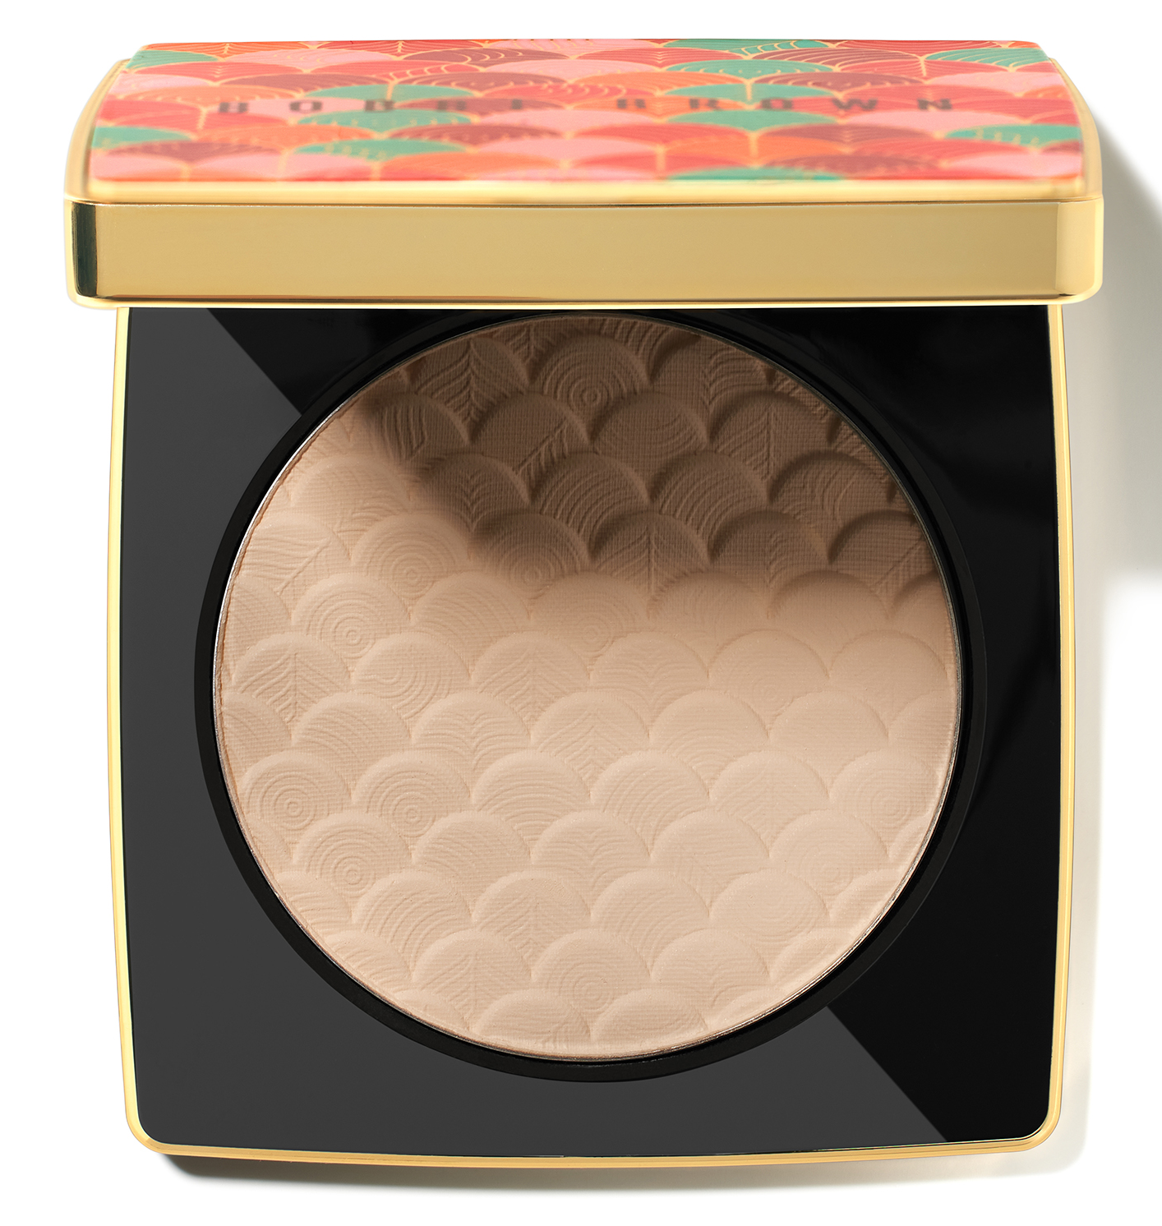
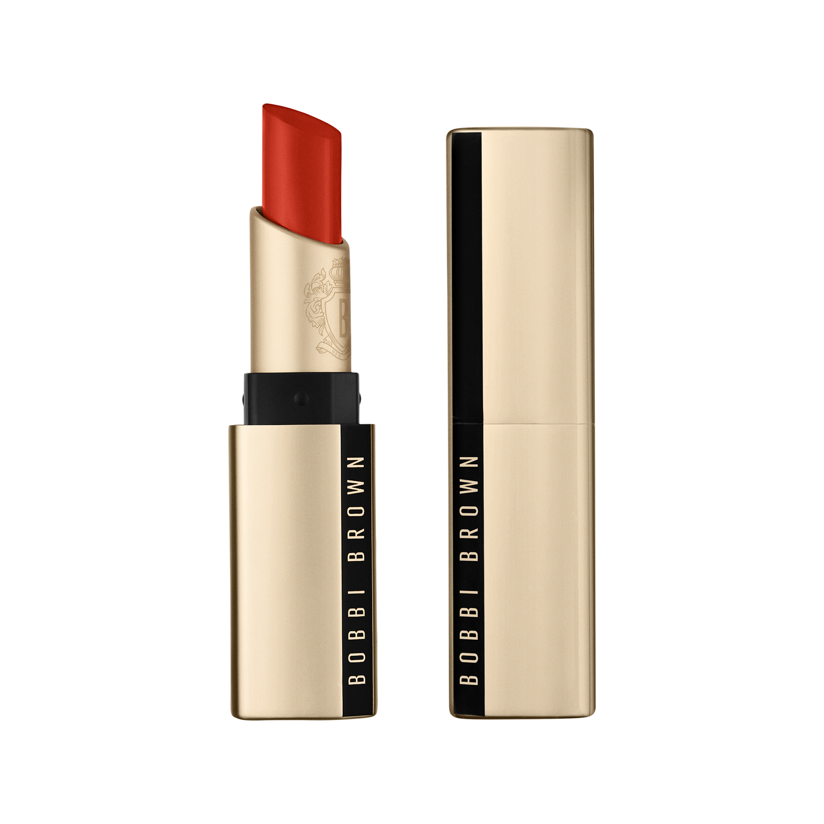
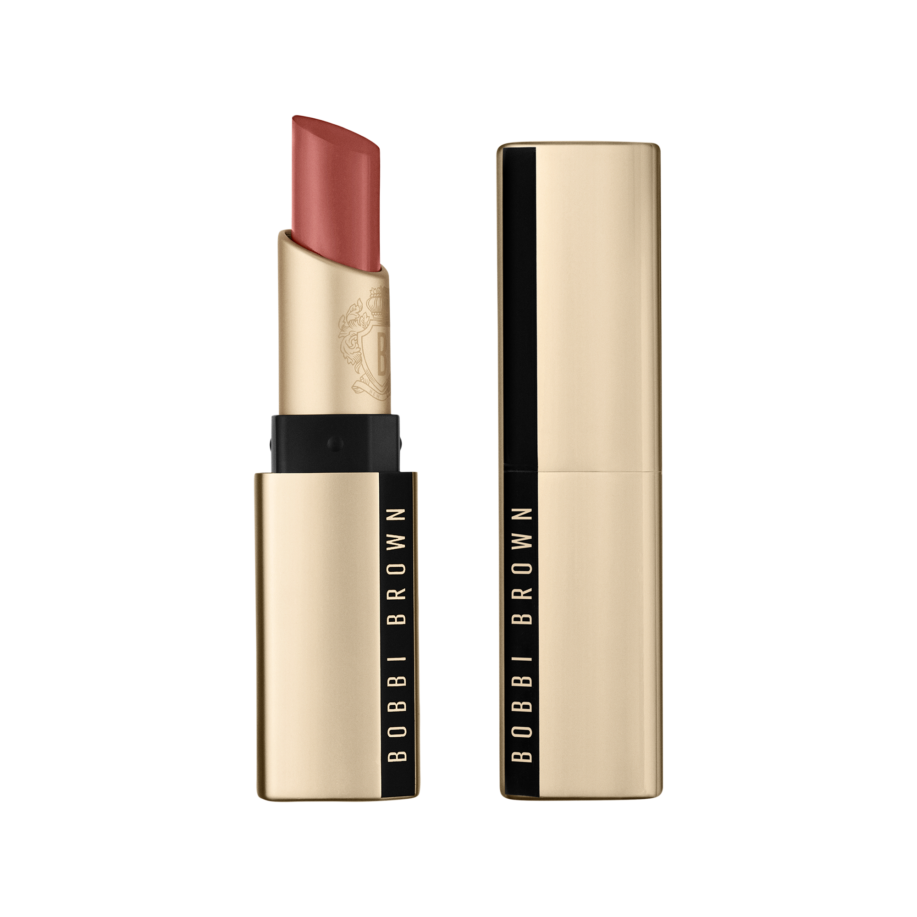
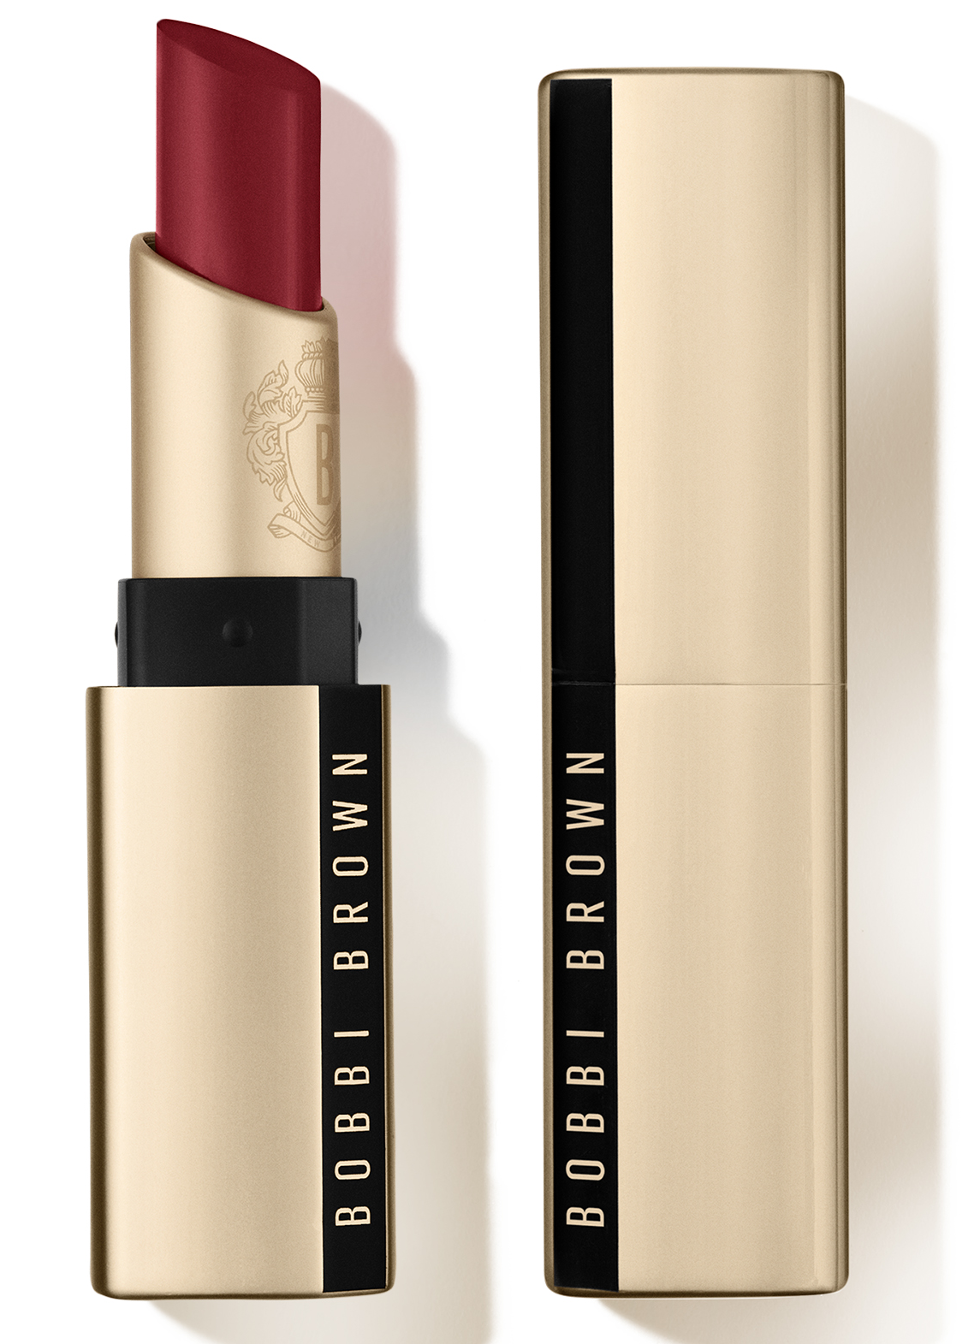
GLOW WITH LUCK COLLECTION
Soothing Cleansing Oil
Containing 98% high-performance ingredients, our gentle yet powerful facial cleansing oil melts away makeup and pollution while deeply nourishing skin to leave it soft and luminous for hours. SRP: €58
Sheer Finish Pressed Powder
Refresh your luck. Set your sights on good fortune with our Sheer Finish Pressed Powder in weightless, undertone-correct pigments. SRP: €52
Luxe Lipstick in RED CARPET, UPTOWN RED, AND BOSS PINK
A non-drying matte lipstick that delivers skincare-infused comfort and 10-hour
color-true wear—in versatile shades designed to suit every skin tone and style. SRP: €46
Red Carpet
Uptown Red
Boss Pink
Available: January 2024 at Bobbi Brown Cosmetics Counters and at www.bobbibrown.be
For more information, please contact Marie Wauters - mwauters@be.clinique.com
Find us on social: @BobbiBrown #BobbiBrown

